Slide 1

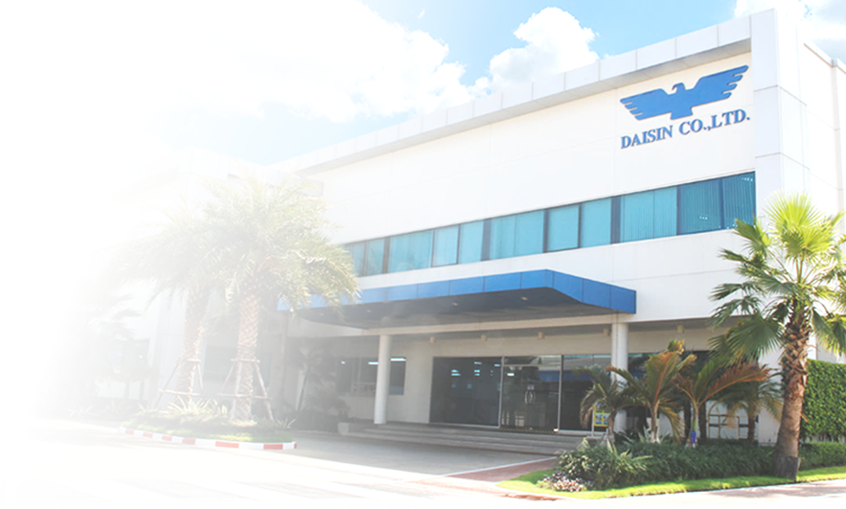
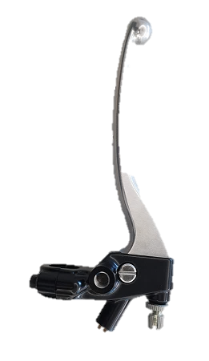
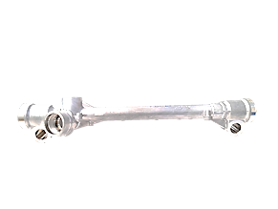

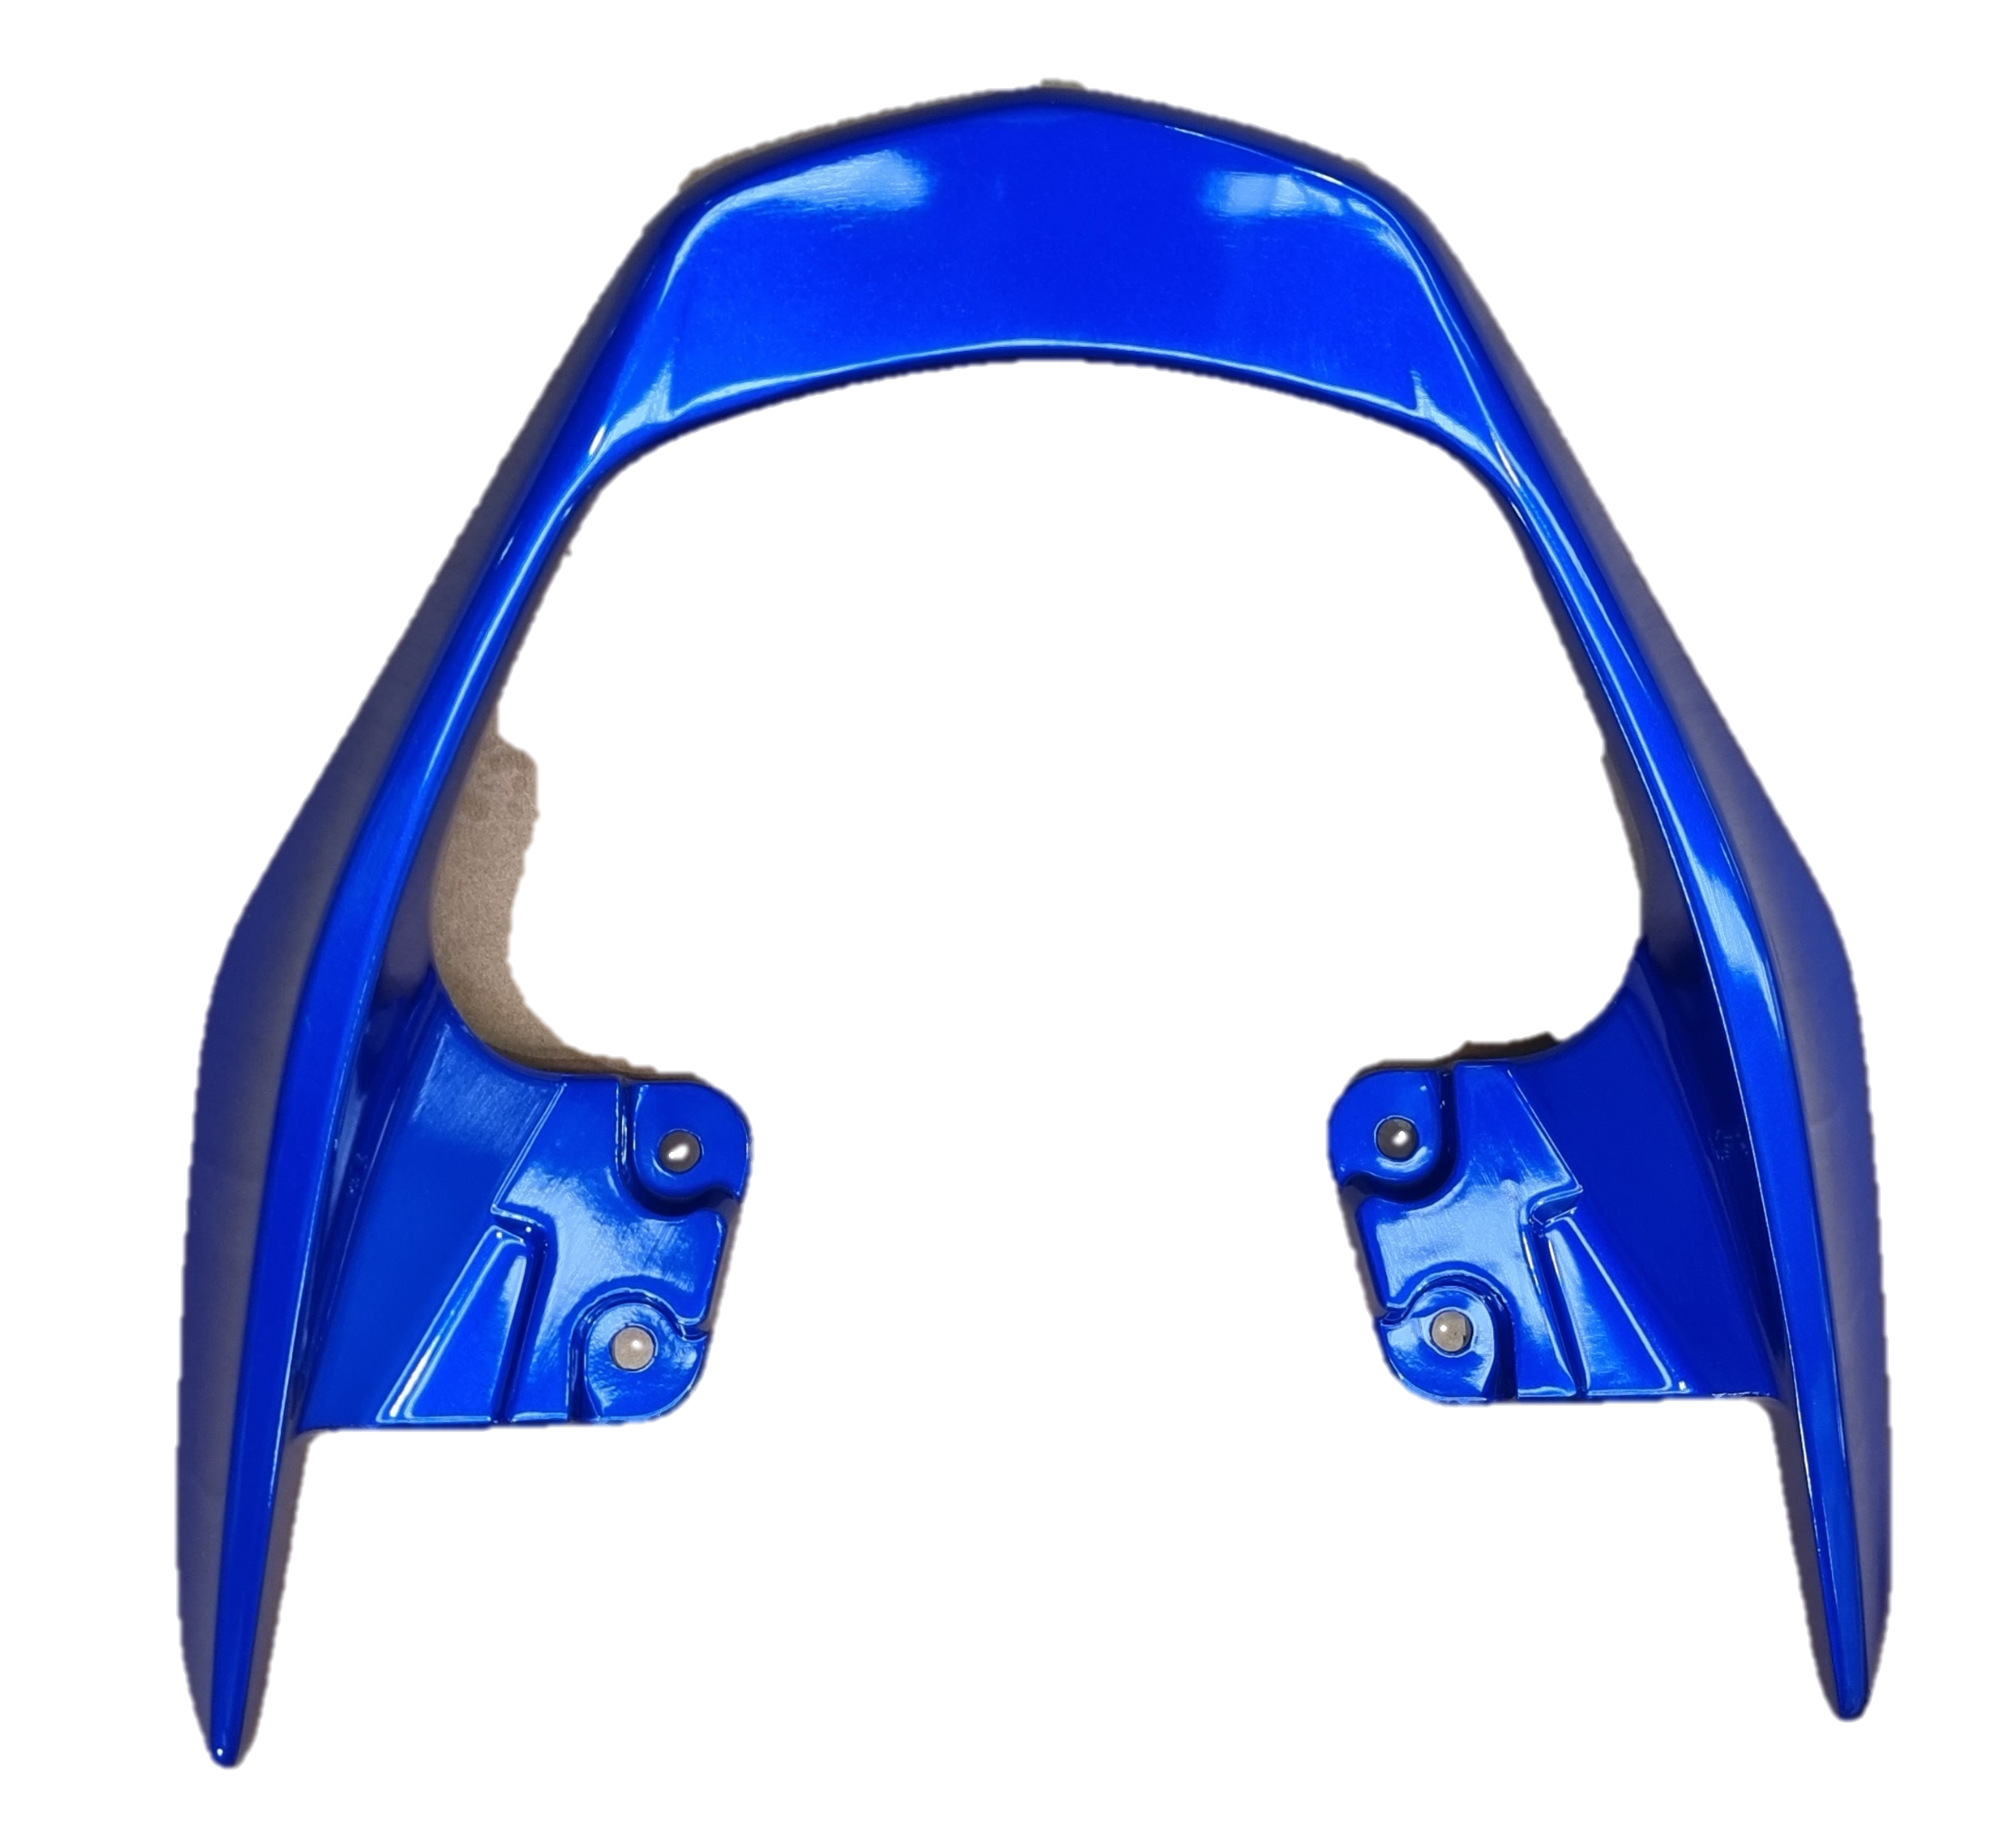
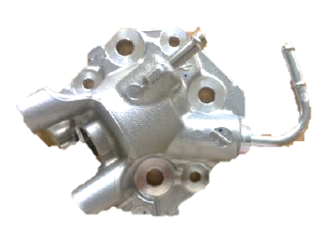
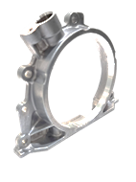
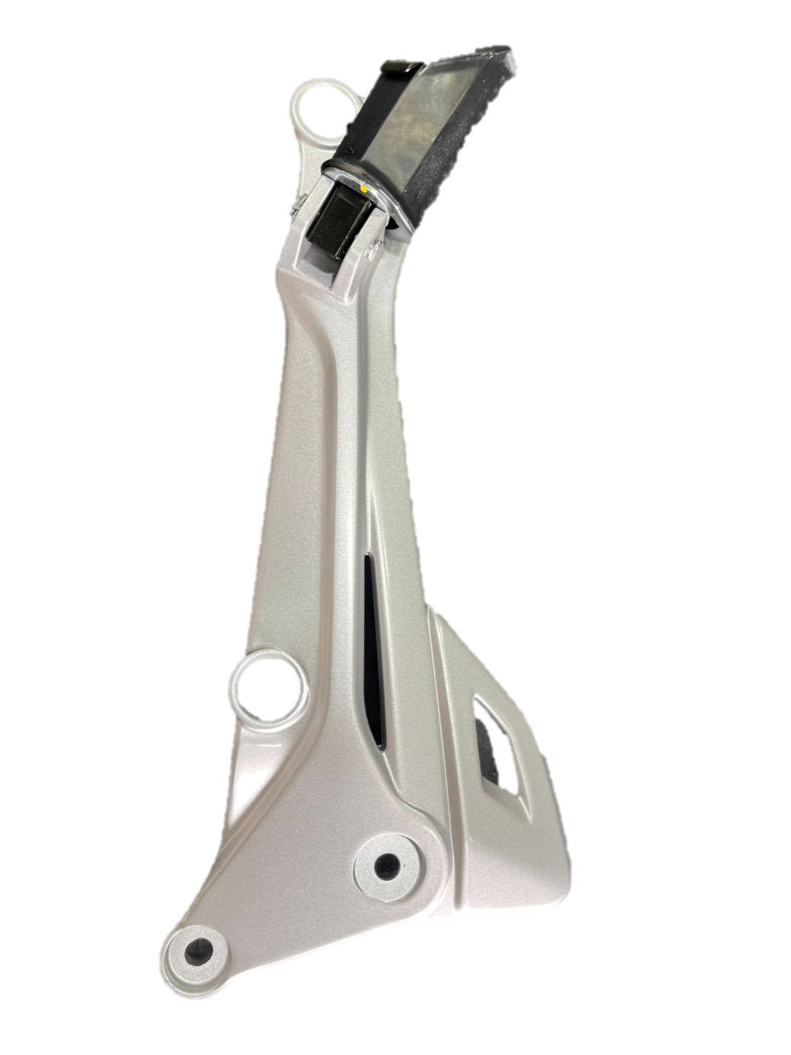
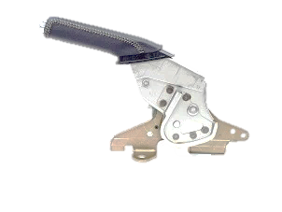
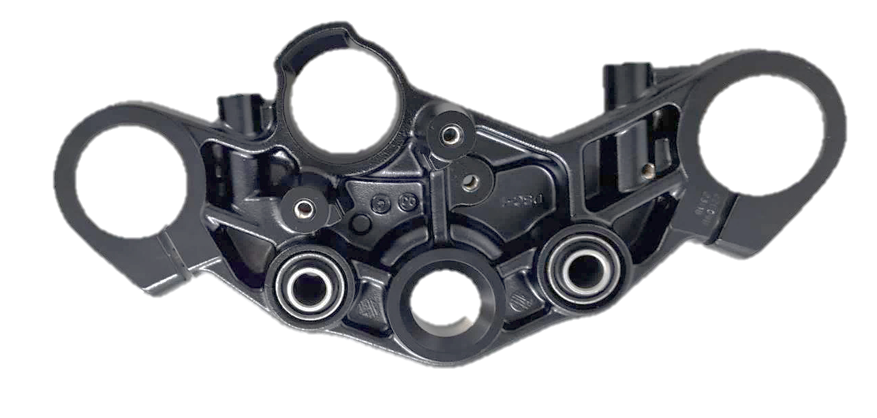
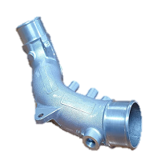

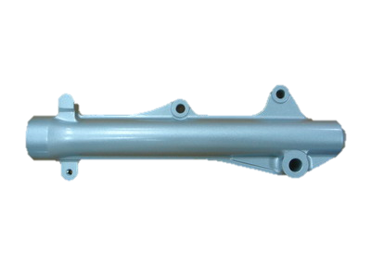

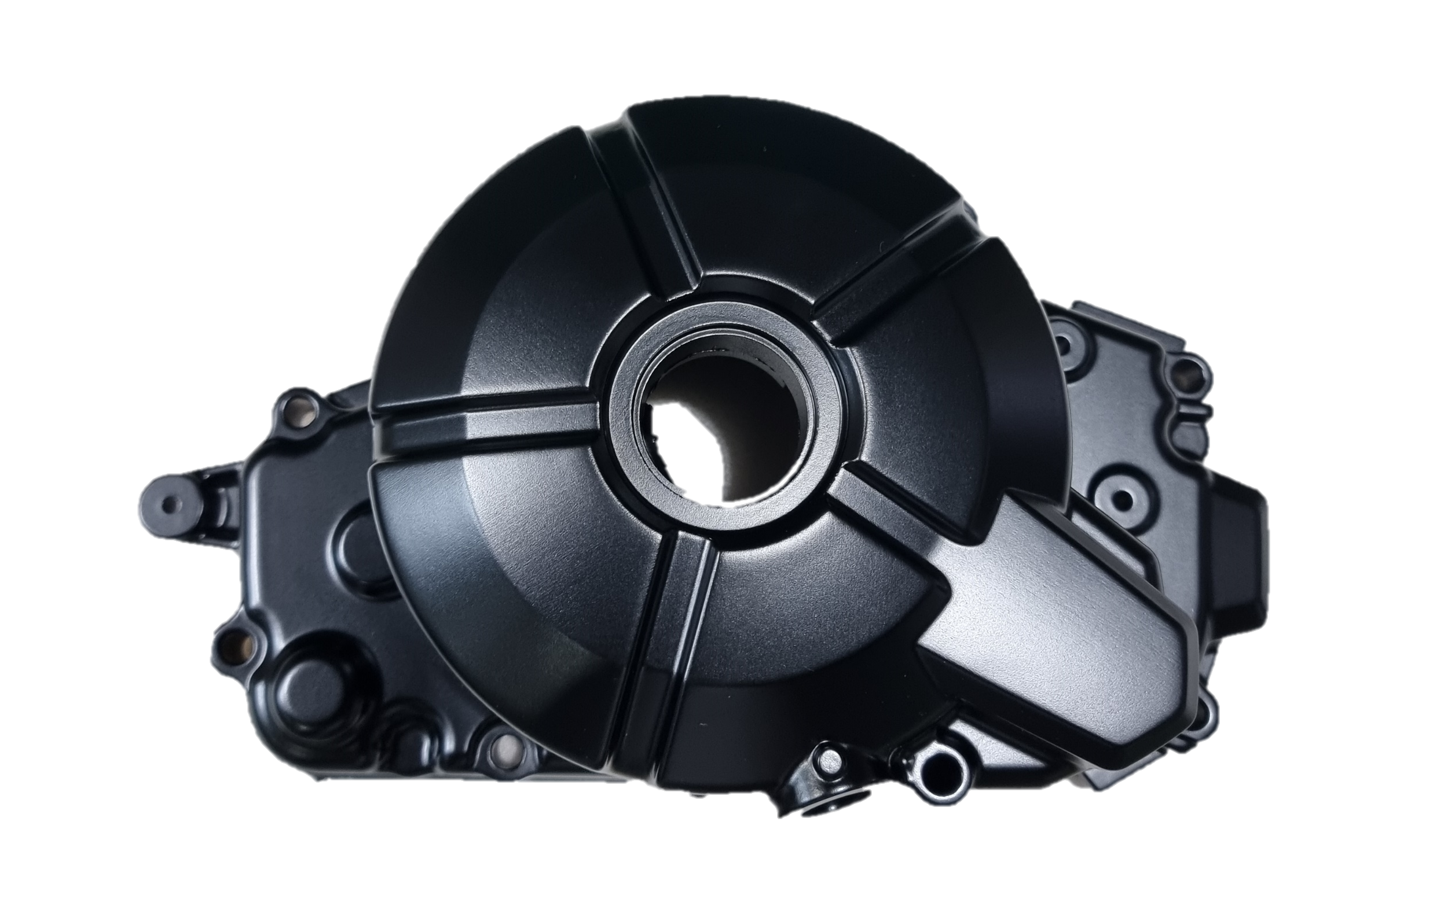
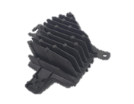
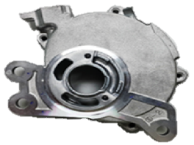
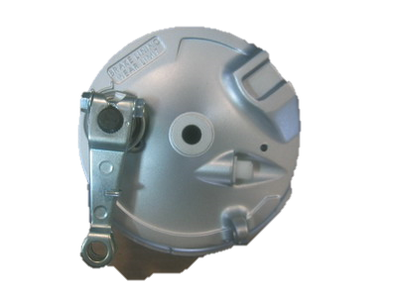
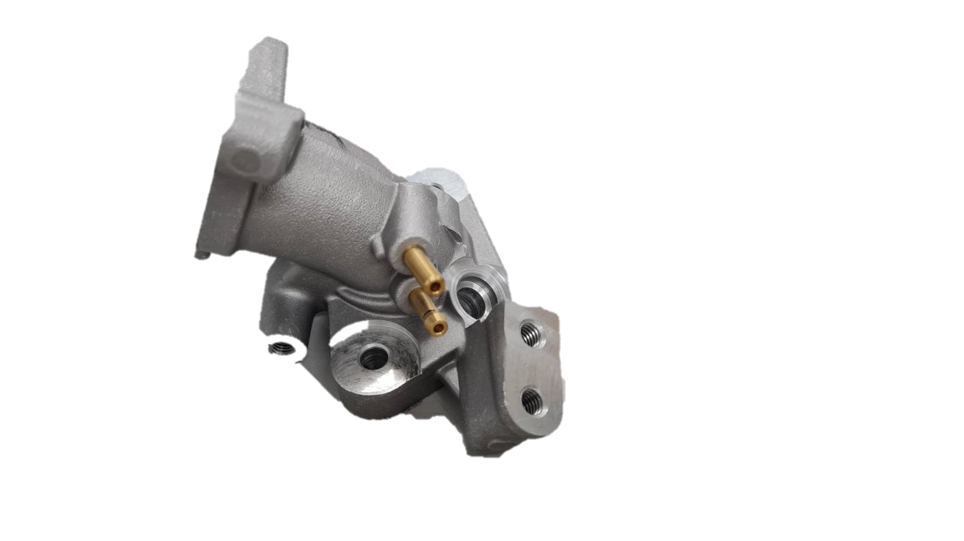
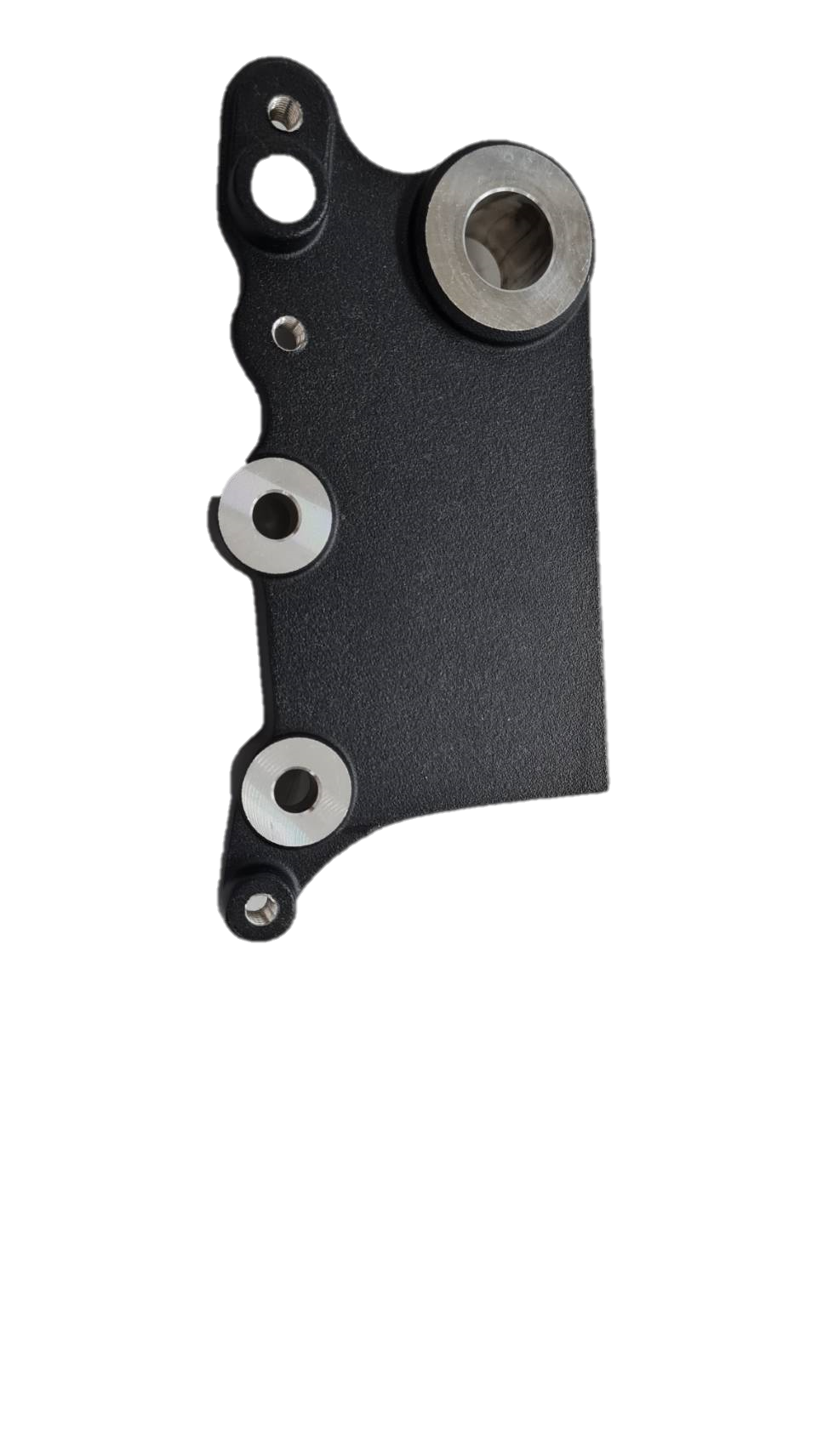
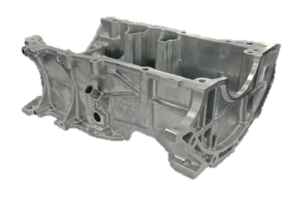
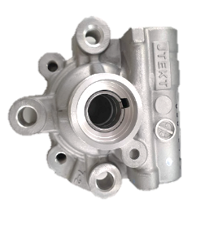
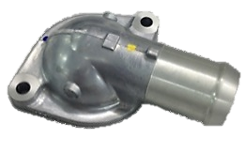
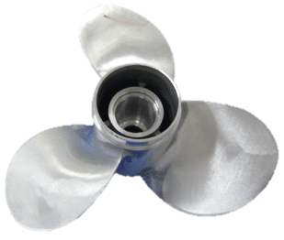
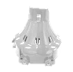
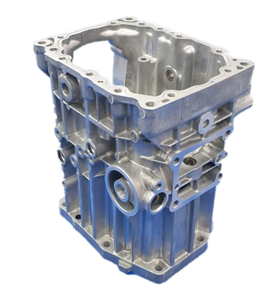
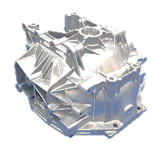
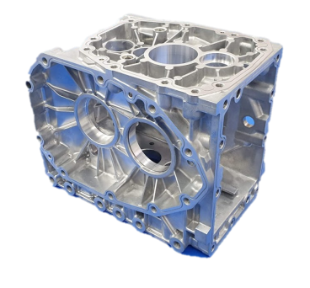
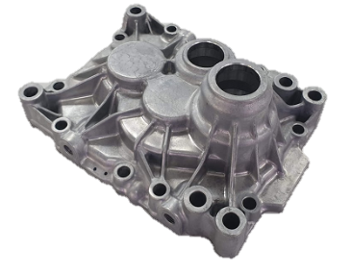
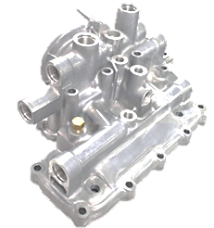
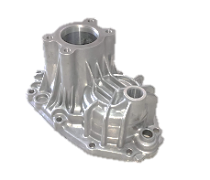


“Our intention is to be Asia’s No.1 Die casting industry”
C
D
WE COMMIT TO
Q
C
D
Q
The leading aluminum die casting parts and parking brake manufacturer of Thailand
Quality
Cost
Delivery
Lever Assy Grip
Retainer Oil Seal
MS Rack
Handle Seat
Holder Injector
Holder Fork Upper
Lever Assy Parking Brake
Step Assy
Outlet Water
Outer Tube
Heat Sink
Casing
Cover Crank Case
Panel Brake
Pipe Inlet
Holder Brake
Housing Thermostat
Pump Front
Crank Case Stiffening
For more Info.
Propeller
Cover Fan
Case Transmission
Housing Clutch
Case Diff Gear
Cover Clutch Housing
Cover Assembly
Case Axle
Contact us : 101/59/3 Moo 20, Navanakorn, Phaholyothin Road, khlong Nueng, Khlong Luang, Pathumthani 12120, Thailand
Tel.(66 2) 529-0070-3, 909-0286-7 Fax.(66 2) 529-2016, 529-0074 www.daisin.co.th

